Slide 1
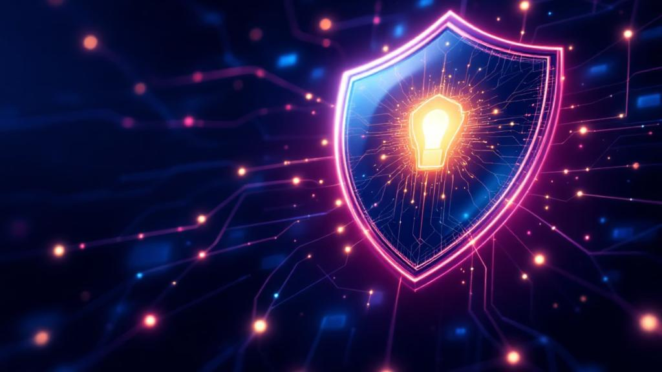
Phishing Awareness
Training
Protect yourself and your organization from cyber threats
Security Training
2025

Slide 2
Why This Matters
91%
$4.9M
Of cyberattacks start with phishing
Average cost of a data breach
Phishing remains the most common attack vector
Financial impact continues to rise annually
1 in 99
Emails are malicious
Constant vigilance is essential

Slide 3
Understanding Phishing

Slide 4
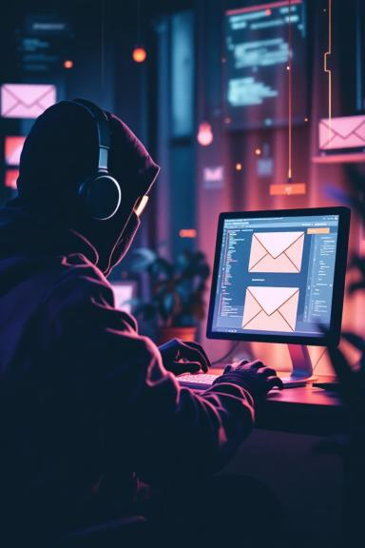
What is Phishing?
Fraudulent Communication
Goal: Steal Information
Passwords, financial data, or install malware
Emails, texts, calls, or websites designed to deceive
Social Engineering
Exploits human psychology and trust

Slide 5




Types of Phishing Attacks
Spear Phishing
Whaling
Smishing
Targeted, personalized attacks using specific information about the victim
High-value targets like executives and senior management
Phishing via SMS text messages with malicious links
Vishing
Voice phishing through phone calls impersonating trusted entities

Slide 6
Recognition Techniques

Slide 7
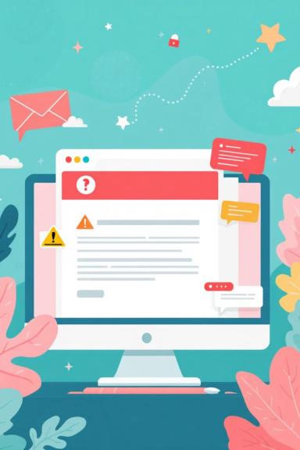
Spotting Phishing Emails
1
Generic Greetings
"Dear Customer" instead of your actual name
2
Urgent Language
Threats of account closure or immediate action required
3
Suspicious Senders
Email addresses that don't match the claimed organization
4
Unexpected Attachments
Unsolicited files or links with misleading URLs

Slide 8
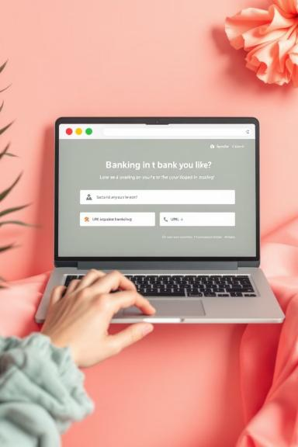
Identifying Fake Websites
Suspicious URLs
Fake Security Indicators
Similar to legitimate sites but with slight variations
Counterfeit padlock icons and SSL certificates
Poor Design Quality
Unexpected Pop-ups
Spelling errors, broken layouts, and unprofessional appearance
Requests for personal information through pop-up windows

Slide 9








Social Engineering Tactics
Creating Urgency
Impersonation
Pressure to act quickly without thinking
Pretending to be trusted entities or colleagues
Psychology Exploitation
Fake Authenticity
Bypassing technical defenses through human manipulation
Using familiar logos and branding to appear legitimate

Slide 10
Consequences of Phishing

Slide 11
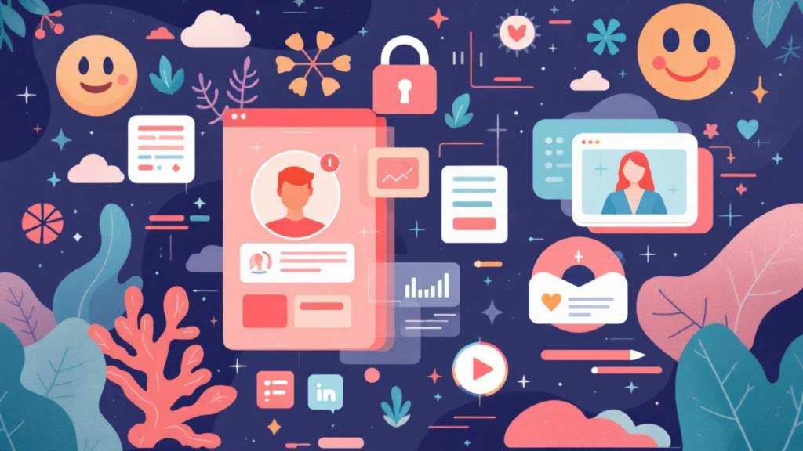
The Real Cost
Personal
Corporate
Identity theft and financial loss
Unauthorized system access
Personal accounts compromised
Company data at risk
Reputation
Brand damage and regulatory fines
Long-term business impact

Slide 12
Best Practices

Slide 13
Your Defense Strategy
Verify Before You Trust
Check sender addresses and domains carefully
Hover Before You Click
Preview URLs to ensure they're legitimate
Never Share Sensitive Info
Legitimate organizations won't ask for passwords via email
Keep Everything Updated
Software patches and security tools stay current
Use Multi-Factor Authentication
Add extra security layers wherever possible

Slide 14





When in Doubt
Report Immediately
Continuous Learning
Alert IT/security team about suspicious emails
Participate in training and simulations
Stay Informed
Build Security Culture
Keep up with latest threats and tactics
Foster team vigilance and awareness

Slide 15
Key Takeaways

Slide 16

Remember
1
Phishing exploits trust
Attackers use psychology, not just technology
2
Recognition is key
Look for urgency, suspicious links, and unusual requests
3
Verify before acting
Never click or share information without confirmation
4
You are the front line
Your awareness protects everyone

Slide 17

Stay Vigilant
Your awareness is our strongest defense
Report suspicious activity immediately and continue learning about evolving threats. Together, we can build a more secure environment for everyone.

